Slide 1
Search Tree Design & Analysis Of Algorithm

Slide 2
Search Tree
A search tree is a data structure that helps you quickly find specific items (called keys) in a collection.
It’s made up of nodes, with each node holding a key.
In a search tree, keys on the left side of a node are smaller, and keys on the right side are larger.

Slide 3
Structure of a Search Tree
Layout: A search tree is structured like an upside-down tree. At the top is the root node, which is the starting point for any operation (like search, insert, or delete). All other nodes are connected to this root.
Root Node: The root is the first and main node of the tree, and there is only one root in a tree.
Child Nodes: Each node can have two or more children:
Left Child: Contains a key smaller than its parent’s key.
Right Child: Contains a key larger than its parent’s key.
Subtrees: The left and right children can themselves be roots of smaller subtrees, following the same left-smaller, right-larger rule.

Slide 4
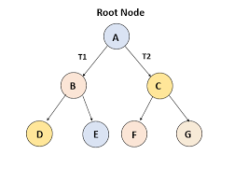
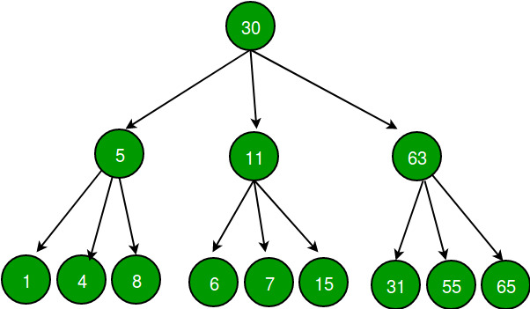

Structure of a Search Tree

Slide 5
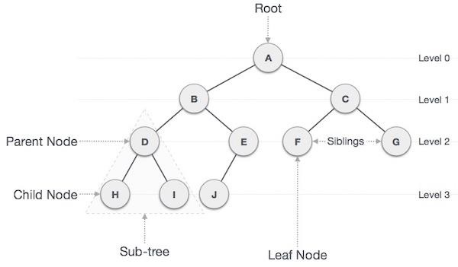
Structure of a Search Tree

Slide 6
Types OF Trees
Binary Search Trees (BST)
AVL Trees
Red-Black Trees
B-Trees

Slide 7
Binary Search Trees (BST)
Definition:
A binary tree in which each node has at most two children, and for each node, the left child's key is less than the node's key, and the right child's key is greater.

Slide 8
Binary Search Trees (BST)
Operations:
Insertion:
Similar to search; place the new value in the correct position where a leaf would be.
Deletion:
Three cases:
Node has no children (leaf):
Simply remove the node.
Node has one child:
Replace the node with its child.
Node has two children:
Find the in-order predecessor (largest in the left subtree) or successor (smallest in the right subtree) to replace the node, then delete the predecessor/successor.
Search:
Begin at the root; if the value is smaller, move left, and if larger, move right. Repeat until found or null

Slide 9
Binary Search Trees (BST)

Slide 10
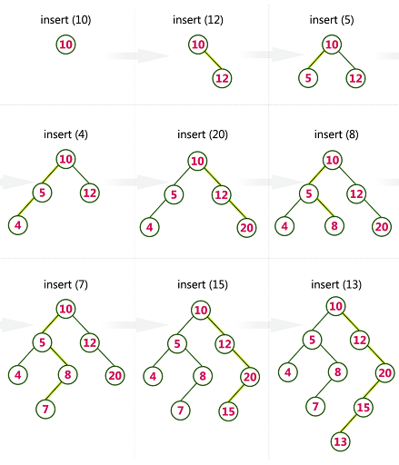
Create BST using Following elements 10,12,5,4,20,8,7,15,13

Slide 11
avl tree
A self-balancing binary search tree (BST).
Balance Factor:
Difference between the heights of the left and right subtrees of any node (must be -1, 0, or 1).
Balancing:
After insertion or deletion, the tree is rebalanced if the balance factor is violated.

Slide 12
avl tree
ROTATIONS
Single Right Rotation (LL Rotation): Applied when the left subtree is taller.
Single Left Rotation (RR Rotation): Applied when the right subtree is taller.
Left-Right Rotation (LR Rotation): Applied when the left subtree’s right child is taller.
Right-Left Rotation (RL Rotation): Applied when the right subtree’s left child is taller.

Slide 13
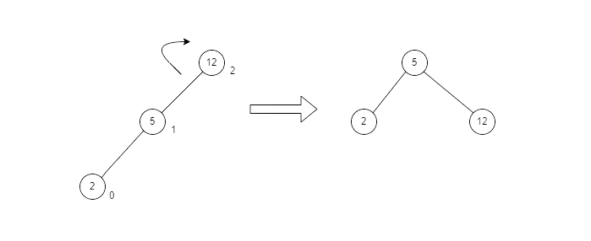
avl tree
LL ROTATION

Slide 14
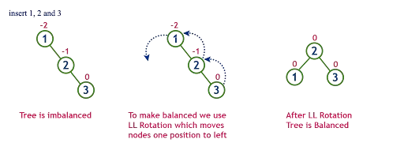
avl tree
RR ROTATION

Slide 15
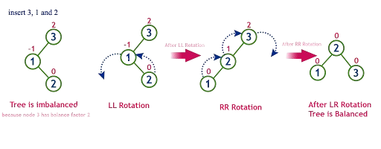
avl tree
LR ROTATION

Slide 16
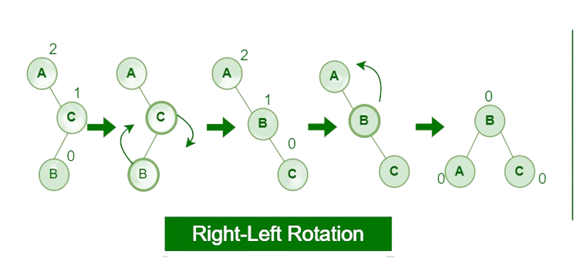
avl tree
RL ROTATION

Slide 17
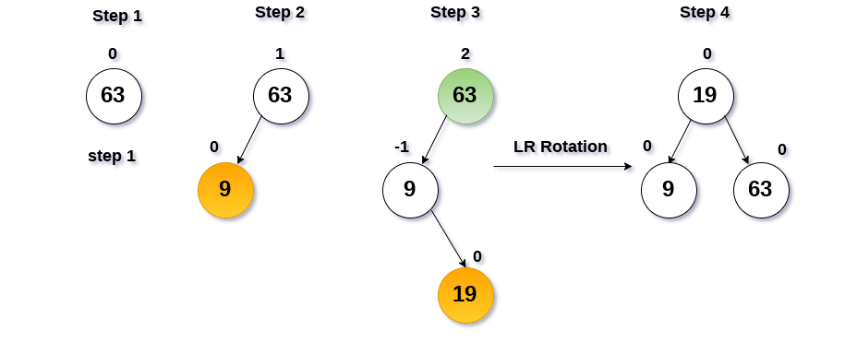
Rotation in AVL Tree Insert values: 63, 9, 19,27,28,108

Slide 18
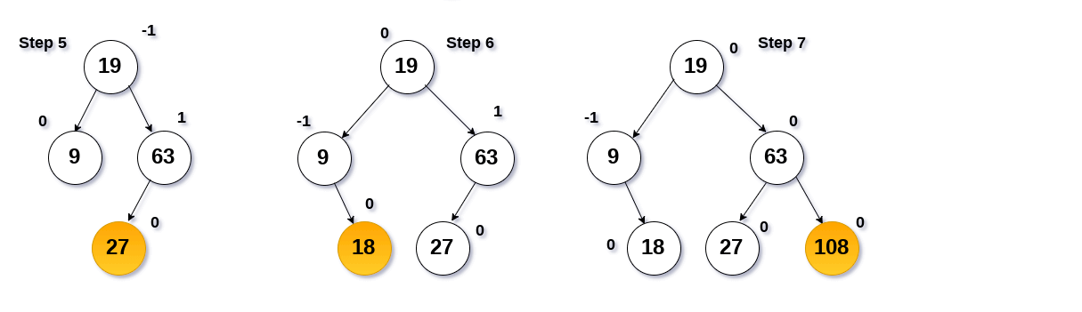
Rotation in AVL Tree Insert Values: 63, 9, 19, 27, 28, 108

Slide 19
RED-BLACK TREE
A Red Black tree is a binary search tree in which:
- Every node is colored either Red or Black.
- Insert the new node with color red if it is root node then recolor it.
- Root node is always black.
- If a node is red, then both of its children are black.
- Every path from a node to a null contains the same number of black Nodes.

Slide 20
Rules for red-black tree
Coloring Rule: Each node is either red or black.
Root Rule: The root node is black.
Red Constraint: No parent-child pair can have both nodes red
Uniform Black Depth: Every path from a node to its descendant leaves has the same count of black nodes.
Leaf Color: All leaf nodes are black.
Internal Property: If a node is red, its parent must be black.
Depth Property: All leaves have the same depth of black nodes.
Path Property: Equal black node count along root-to-leaf paths.
Root Property: The top node is always black.

Slide 21
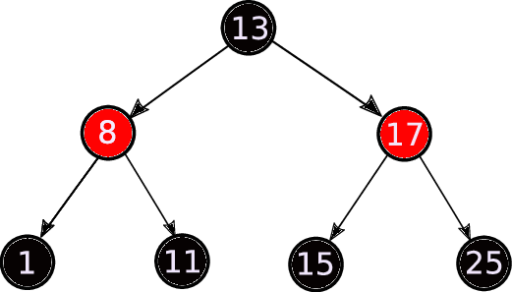
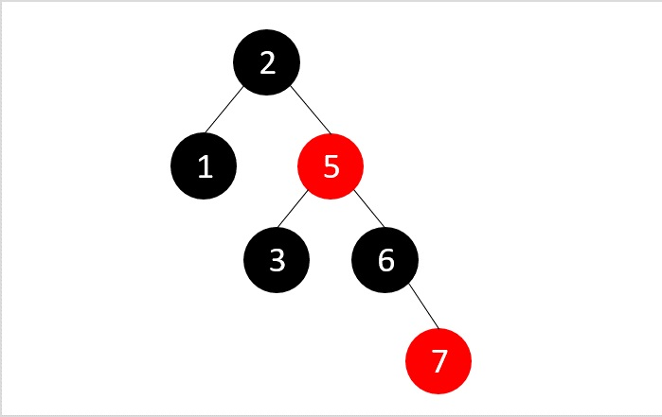
Example RBT

Slide 22
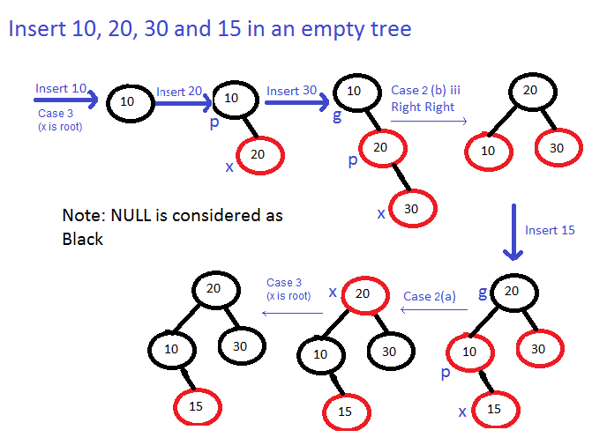

Slide 23
B-TREE
A balanced binary tree, also referred to as a height-balanced binary tree, is defined as a binary tree in which the height of the left and right subtree of any node differ by not more than 1.
(-1,0,1)
Following the conditions for balanced binary tree:
1. Difference between the left and the right subtree for any node is not more than one
2. The left subtree is balanced
3. The right subtree is balanced

Slide 24
Why we use b-tree
When searching tables held on disc, the cost of each disc transfer is high but doesn't depend much on the amount of data transferred, especially if consecutive items are transferred
If we use a B-tree of order 101, say, we can transfer each node in one disc read operation
A B-tree of order 101 and height 3 can hold 101⁴ – 1 items (approximately 100 million) and any item can be accessed with 3 disc reads (assuming we hold the root in memory)
If we take m = 3, we get a 2-3 tree, in which non-leaf nodes have two or three children (i.e., one or two keys)
B-Trees are always balanced (since the leaves are all at the same level), so 2-3 trees make a good type of balanced tree

Slide 25
An example B-Tree
26
A B-tree of order 5 containing 26 items
6
12
42
51
62
1
2
4
7
8
13
15
18
25
27
29
45
46
48
53
55
60
64
70
90
Note that all the leaves are at the same level

Slide 26
Constructing a B-tree
Add 25 to the tree
1 12 8 2 25 6 14 28 17 7 52 16 48 68 3 26 29 53 55 45
Exceeds Order. Promote middle and split.
1
2
8
12
25

Slide 27
Constructing a B-tree (contd.)
8
1 12 8 2 25 6 14 28 17 7 52 16 48 68 3 26 29 53 55 45
1
2
12
25
6, 14, 28 get added to the leaf nodes:
8
1
2
6
14
28
1
2
12
25

Slide 28
Constructing a B-tree (contd.)
Adding 17 to the right leaf node would over-fill it, so we take the middle key, promote it (to the root) and split the leaf
8
1 12 8 2 25 6 14 28 17 7 52 16 48 68 3 26 29 53 55 45
1 12 8 2 25 6 14 28 17 7 52 16 48 68 3 26 29 53 55 45
25
28
28
1
2
6
17
2
12
14

Slide 29
Constructing a B-tree (contd.)
7, 52, 16, 48 get added to the leaf nodes
8
17
1 12 8 2 25 6 14 28 17 7 52 16 48 68 3 26 29 53 55 45
7
25
28
48
1
2
6
12
14
52
16

Slide 30
Constructing a B-tree (contd.)
Adding 68 causes us to split the right most leaf, promoting 48 to the root
1 12 8 2 25 6 14 28 17 7 52 16 48 68 3 26 29 53 55 45
8
17
1
2
6
7
12
14
16
25
28
48
52
68

Slide 31
Constructing a B-tree (contd.)
Adding 3 causes us to split the left most leaf
8
17
48
1 12 8 2 25 6 14 28 17 7 52 16 48 68 3 26 29 53 55 45
7
2
6
7
12
14
16
1
3
25
28
52
68

Slide 32
Constructing a B-tree (contd.)
Add 26, 29, 53, 55 then go into the leaves
3
8
17
48
1 12 8 2 25 6 14 28 17 7 52 16 48 68 3 26 29 53 55 45
1
2
6
7
12
14
16
25
26
28
52
53
68
55
29

Slide 33
Constructing a B-tree (contd.)
Add 45 increases the trees level
Exceeds Order. Promote middle and split.
1 12 8 2 25 6 14 28 17 7 52 16 48 68 3 26 29 53 55 45
Exceeds Order. Promote middle and split.
3
8
17
48
1
2
6
7
12
14
16
25
26
28
29
45
52
53
55
68

Slide 34
Inserting into a B-Tree
Attempt to insert the new key into a leaf
If this would result in that leaf becoming too big, split the leaf into two, promoting the middle key to the leaf’s parent
If this would result in the parent becoming too big, split the parent into two, promoting the middle key
This strategy might have to be repeated all the way to the top
If necessary, the root is split in two and the middle key is promoted to a new root, making the tree one level higher

Slide 35
Exercise in Inserting a B-Tree
Insert the following keys to a 5-way B-tree:
3, 7, 9, 23, 45, 1, 5, 14, 25, 24, 13, 11, 8, 19, 4, 31, 35, 56

Slide 36
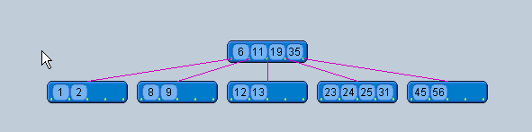
Answer to Exercise

Slide 37
Analysis of B-Trees
The maximum number of items in a B-tree of order m and height h:
root m – 1
level 1 m(m – 1)
level 2 m²(m – 1)
. . .
level h m^{h}(m – 1)
So, the total number of items is (1 + m + m² + m³ + … + m^{h})(m – 1) = [(m^{h+1} – 1)/ (m – 1)] (m – 1) = m^{h+1} – 1
When m = 5 and h = 2 this gives 5³ – 1 = 124

Slide 38
Thank You

